Slide 1

Group 1 Pitch
Emma Banks
Shantanu Jamble
Victor Shu
Yijun Wu

Slide 2

Brief Idea
High-tech setting
Fantasy world with magics and sorcery
Magics are developed through science
Adventure RPG
Notes:
Brief idea:
The story happens in a high-tech planet, where some kind of magic or sorcery are developed by science and technology. The player plays as a magician with a solid skill of casting and researching magic spells to completes his or her adventure in this “Fantasy High-Tech World”.

Slide 3

Sources

Slide 4
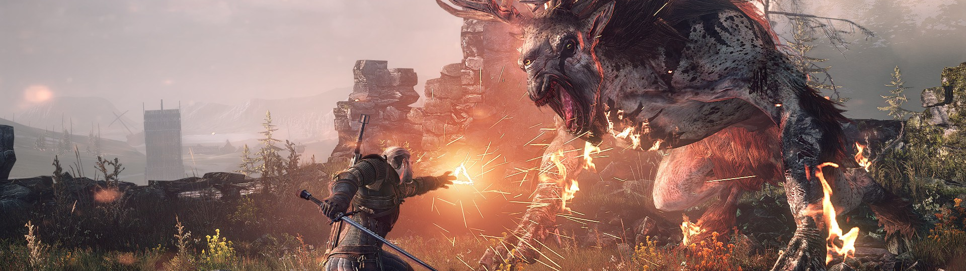

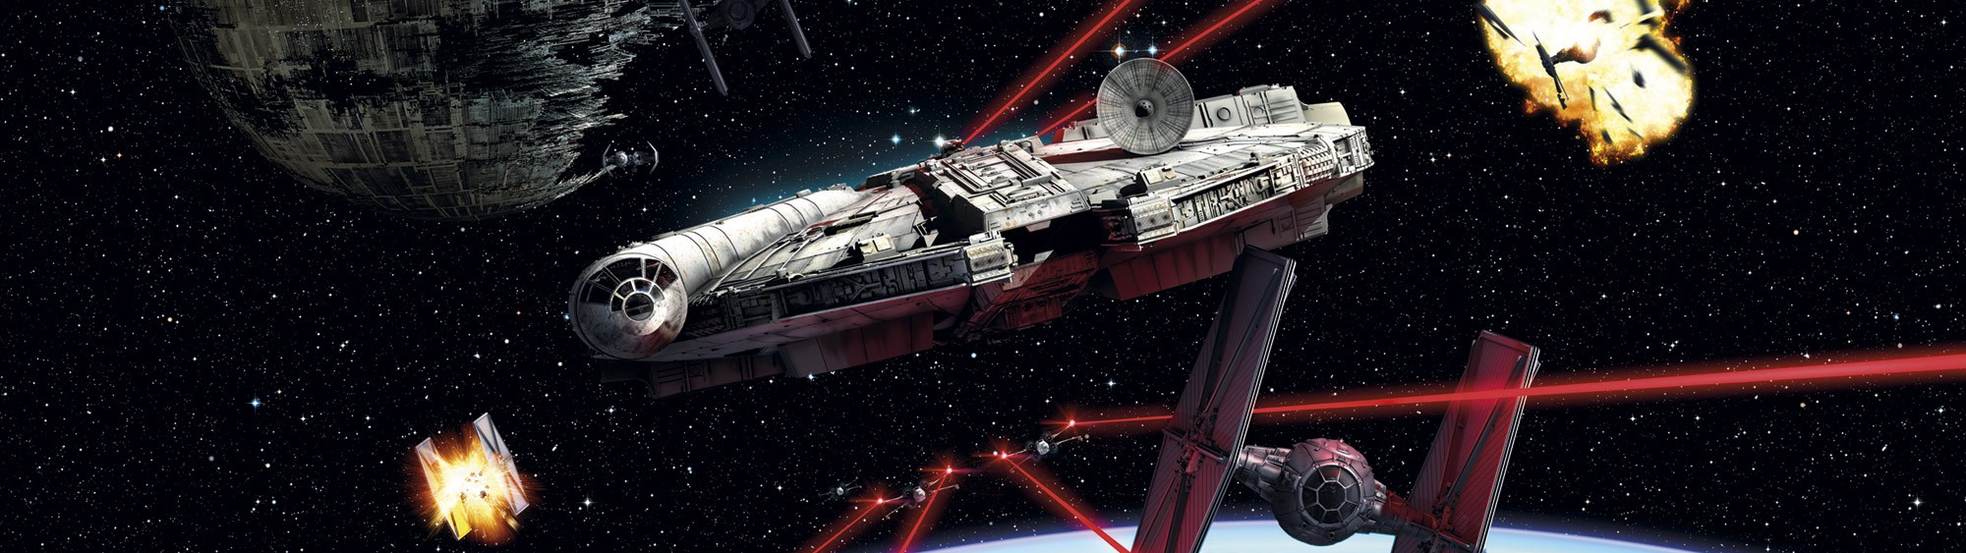


Slide 5
The point

Slide 6
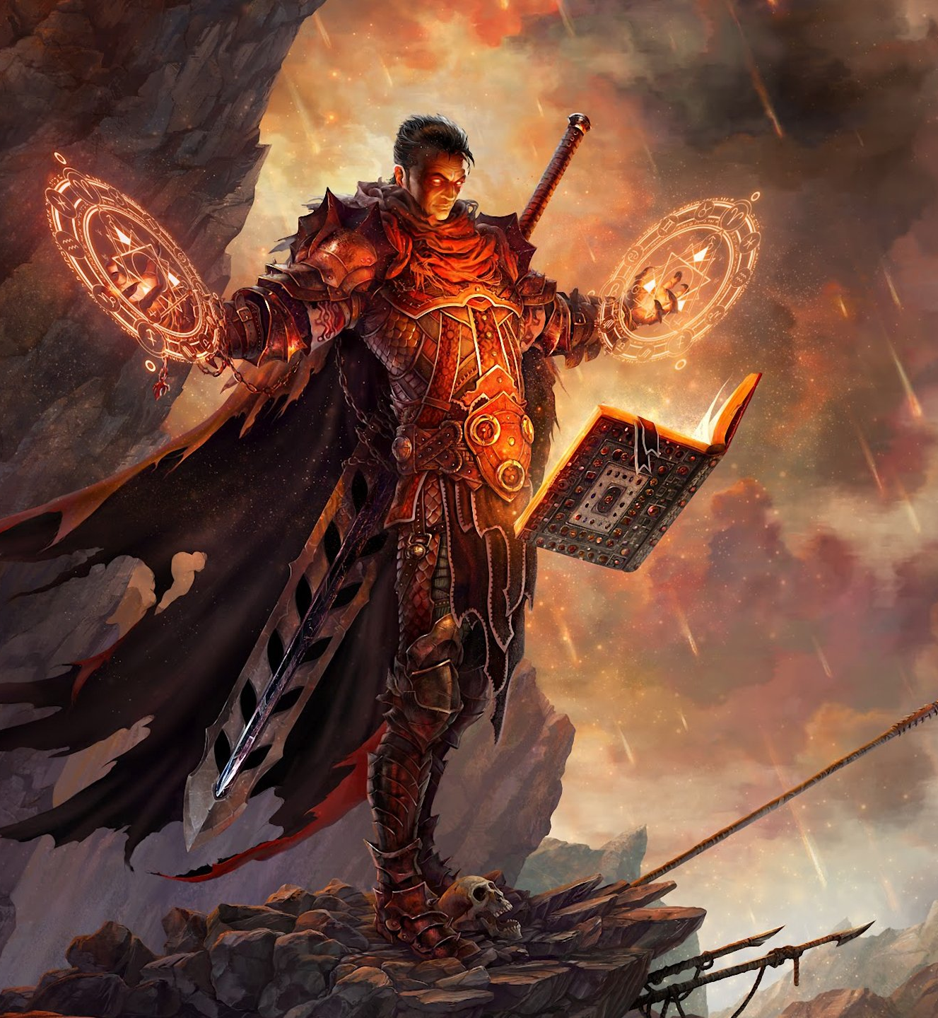
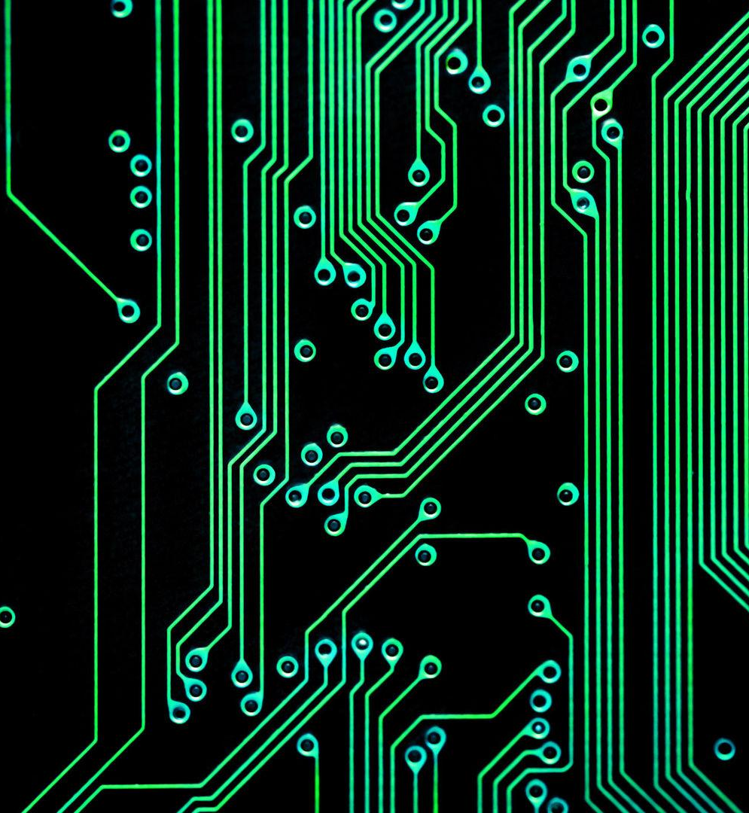
Notes:
Combine the magic and fantasy element in The Witcher and the high-tech setting of Star Wars and create a world even more fantasy. The so-called high-tech magic emphasizes both magical skillsets and technological research and development. The story, like The Witcher and Star Wars, can be an epic adventure.

Slide 7
Gameplay

Slide 8
RPG Game
Player
Magic Spell
Enemy
Notes:
The basic gameplay will be like the adventure RPG games. The player, as a scholar in researching and developing magic spells, will meet many friends and enemies, and complete his great adventure. The player uses magic spells to attack or defense.

Slide 9

RPG Game
Fire
Lv. 10 +1
ATK 124 +12
DEF 98 +9
SPD 111 +7
New Spell Piece!
Research Point +12
Notes:
When the player levels up, he can not only have his basic abilities like ATK or DEF increased, which is a basic element in RPG games, but also get some new spell pieces and research points.

Slide 10
R&D
Fire
Long-Range
3 Research Point
5 Research Point
Fireball
Notes:
The player can develop some new kind of spells by doing scientific researches.

Slide 11
Questions?

